Slide 1




Adaptive Audio to Player Actions and Gameplay: a new Video Game Aline Hufschmitt∗, Stéphane Cardon∗, Jules Borel†, Florian Wolf†, Maël Addoum† † R&D Lab, ISART Digital, Paris, France ∗ CREC, Ecoles de Saint-Cyr Coëtquidan, Guer, France

Slide 2
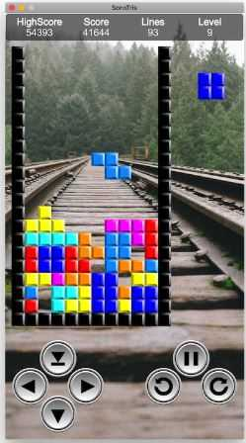
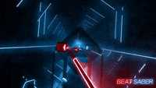
Motivations & contribution
Hypothesis
Tempo synchronization affects player performance differently depending
if it is aligned with
Gameplay (as in Tetris) ¹ ?
player actions (as in Beat Saber) ² ?
Objectives
Evaluate the impact of musical synchronization on
player performance, both in response to
1- game state changes (as in Tetris)¹
2- real-time player decisions (as in Beat Saber)²
Contribution
Design and create our customized 3D video game with an adaptive dynamic audio
System → easily switch its synchronization on game states or player decisions
^{[1]} Aline Hufschmitt, Stéphane Cardon, and Eric Jacopin. Dynamic manipulation of player performance with music tempo in tetris. In Proceedings of the 26th International Conference on Intelligent User Interfaces, IUI ’21, page 290–296, New York, NY,
[2] Iannis Albert, Nicole Burkard, Dirk Queck, and Marc Herrlich. The effect of auditory-motor synchronization in exergames on the example of the vr rhythm game beat saber. 6(CHI PLAY), oct 2022.

Slide 3
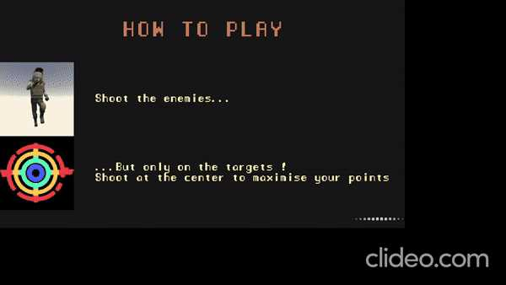
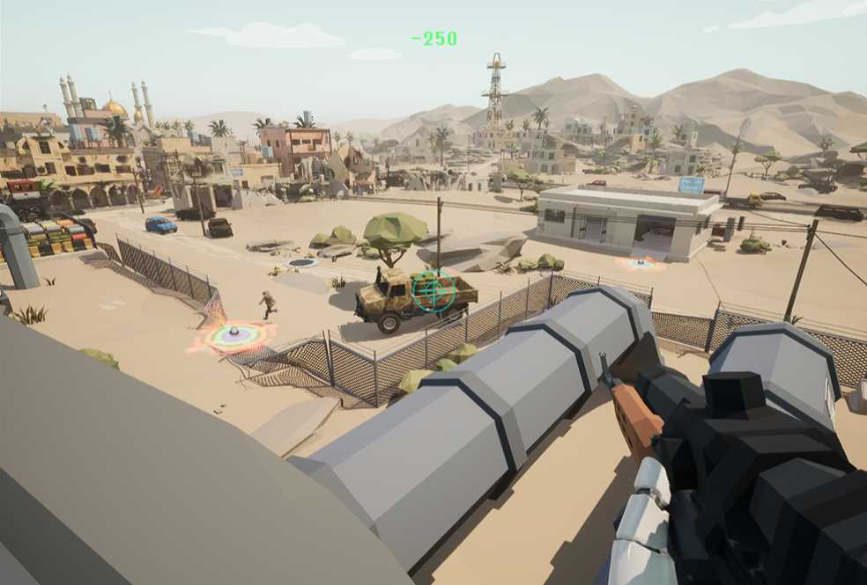


Game : The Eye of Sahara
FPS Game with Military Context
4 Levels of 2 minutes
Increasing of difficulty level
Enemies can appear at different locations in the game world, each following a different trajectory using Unreal’s spline path system.
The player takes on the role of a first-person shooter
They should eliminate enemy soldiers only when they enter predefined target zones

Slide 4
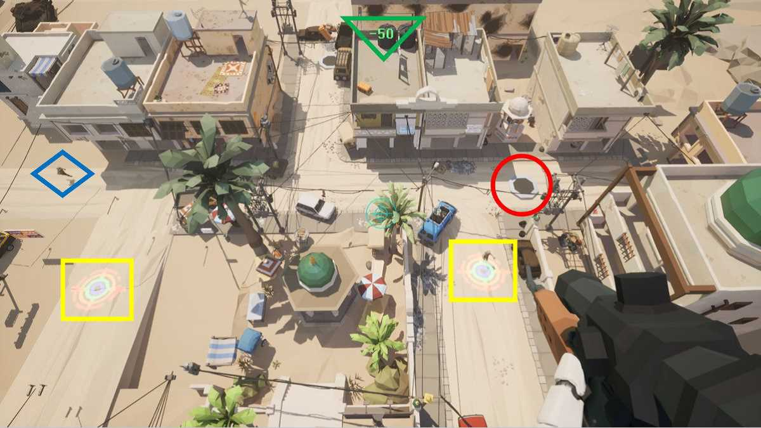
Player Performance (score) /difficulty level
Player’s score : eliminate enemy (+200) or missed enemy (-50)
The score depends on the precision of the action: maximum points are awarded only if the target is eliminated at the center of the window
The number of :
shooting windows,
enemies,
movement speed
Increases with each level
To assess the effect of synchronization combined with increased workload on player performance

Slide 5
Synchronized Adaptive Audio System
3 configurations
1. Players’ actions
enemies’ deployment and progression speed are calculated to arrive at the center of the shooting window precisely on a pulse.
2. Game states
enemies appear in rhythm with the pulse but reach the center of the window randomly between 2 pulses
3. Neutral configuration
no music synchronization and stinger are perceptible.
1. Player action : Enemy at the center of a shooting window
Transmitted Pulses
Synchronous events
2. Game state : spawn of enemies
Activate stingers
3. Neutral configuration

Slide 6
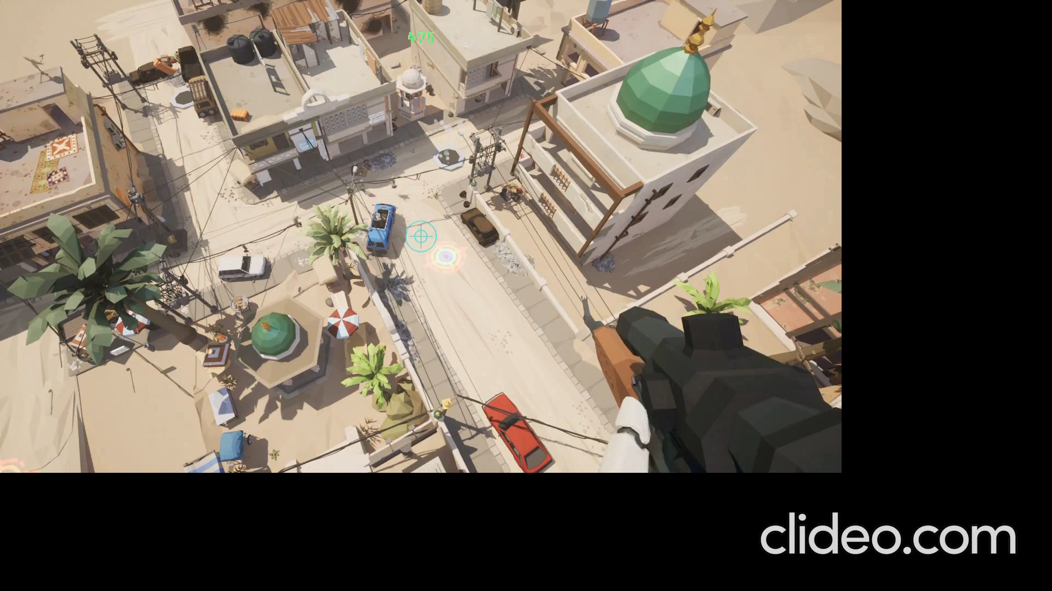
Synchronized Adaptive Audio System
TO GAME STATE @ LEVEL 2

Slide 7
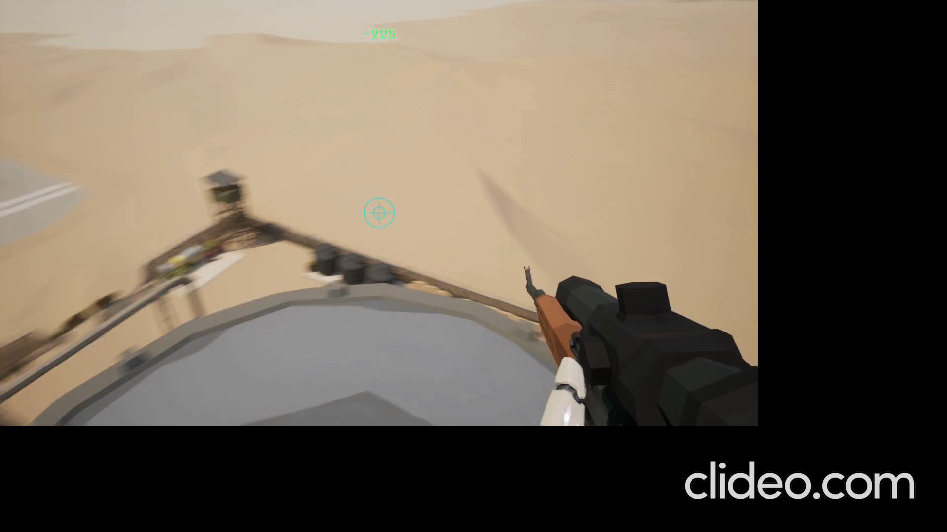
Synchronized Adaptive Audio System
TO GAME STATE @ LEVEL 3

Slide 8
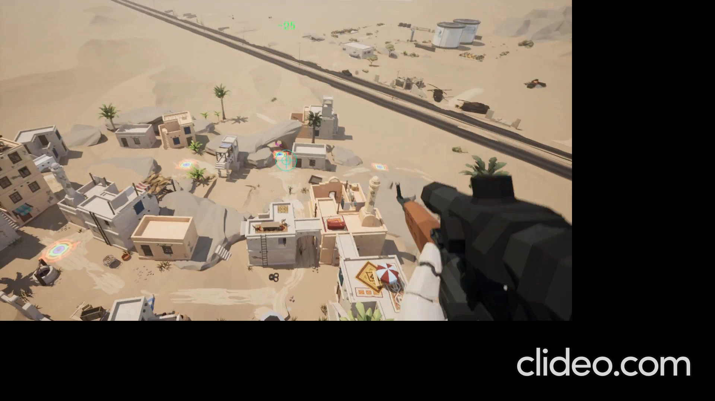
Synchronized Adaptive Audio System
TO PLAYER ACTION @ LEVEL 4

Slide 9
EXPERIMENTAL SETUP
For playtests and survey
New Player
Unique ID
Playing Habits data
(frequency & expertise)
synchronization mode:
state (spawn)
Action (enemy at the target)
No synchro
During each level, in-game data is collected
Pulses / stingers,
enemy /target window positions,
cursor movements,
click down
release events,
After each of the four levels, players complete a form to Evaluate:
user experience,
enjoyment,
fluidity,
task load.

Slide 10
Conclusions
Creation of a customized 3D video game to easily adjust the music synchronization, either to game states or to player actions.
Synchronization was coupled with the game’s difficulty, increasing across four levels.
An executable version of the game can be available.
The sound is accurately triggered and synchronized according to the two events (enemies’ appearance and their reaching the target zones).
Future Perspectives
We intend to perform experimental tests to analyze collected in-game data (qualitative and quantitative) to validate our research hypothesis.
The game is designed for VR headset with eye and heart rate tracking, and GSR, etc. To assess the players’ cognitive functions (attention, gaze pattern, memory, spatial awareness, etc.).

Slide 11
THANK YOU

